Slide 1

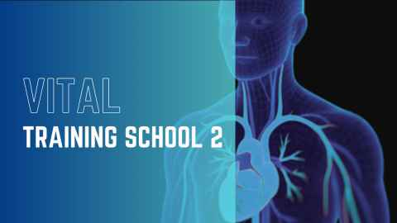
Tutorial on BG/CellML modelling tools
Peter Hunter, David Brooks, Alan Garny, David Nickerson
Auckland Bioengineering Institute
Creating BG/CellML models with CellDL
Interactive simulations with OpenCOR
This tutorial is available at https://opencor.ws

Slide 2

Creating BG/CellML models with CellDL
CellDL
https://celldl.github.io/CellDLEditor
(soon to be available from https://opencor.ws/app)
Developer: David Brooks, Auckland Bioengineering Institute

Slide 3
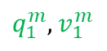
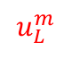
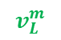
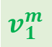



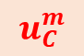
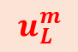
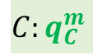
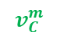
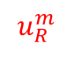
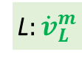
Mechanics example
Mass/spring/damper system
Bond graph model
$$C:q_{C}^{m}$$
R
$$u_{C}^{m}$$
$$u_{R}^{m}$$
$$v_{C}^{m}$$
$$v_{R}^{m}$$
C
R
$$u_{C}^{m}$$
$$v_{1}^{m}$$
$$u_{R}^{m}$$
$$u_{L}^{m}$$
$$u_{L}^{m}$$
$q_{1}^{m},v_{1}^{m}$
L
$$v_{L}^{m}$$
L$:{\dot{v}}_{L}^{m}$

Slide 4
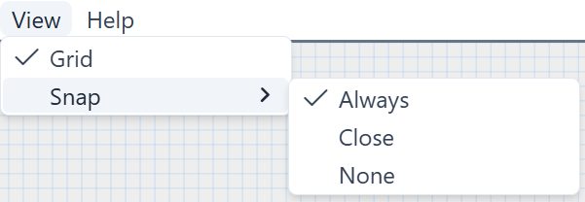
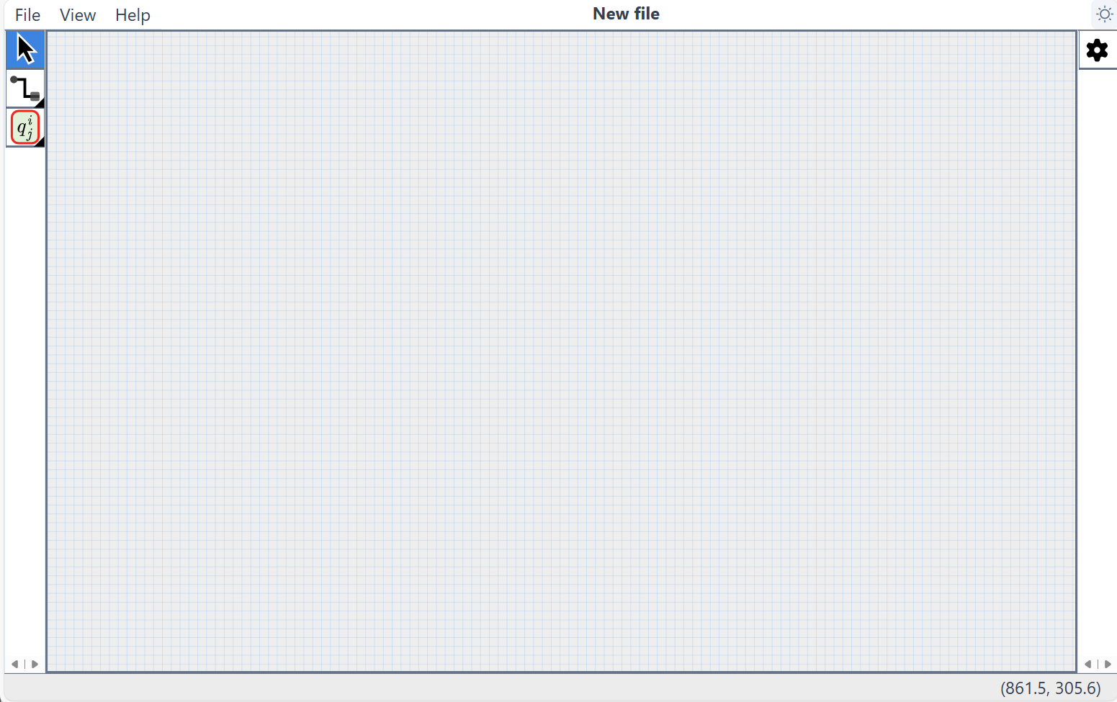

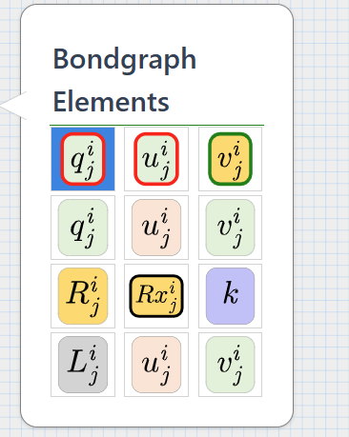
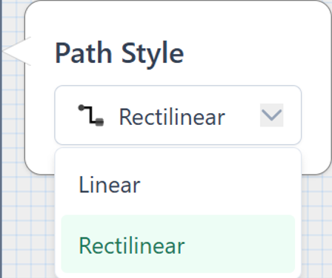

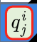
2. Open editor https://celldl.github.io/CellDLEditor
Dark mode
Selection tool

Slide 5
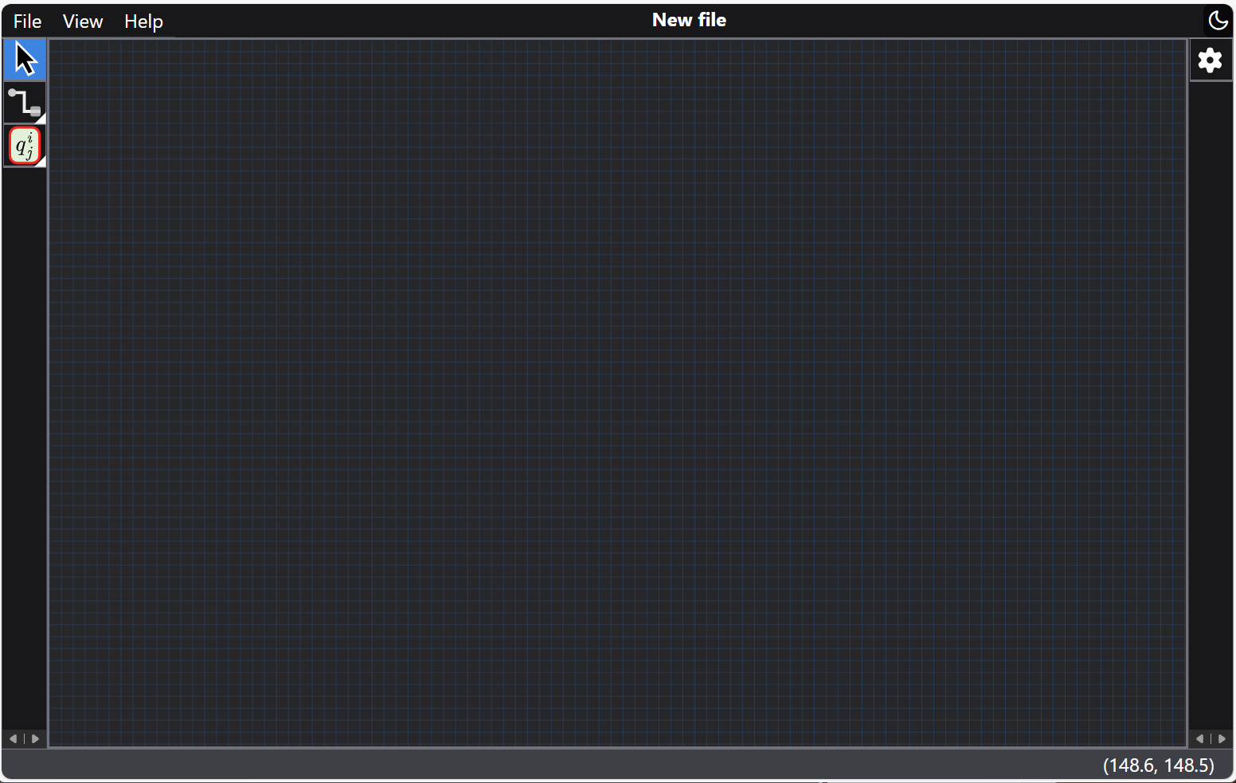
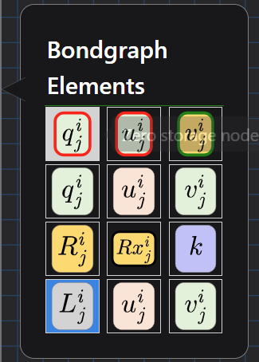
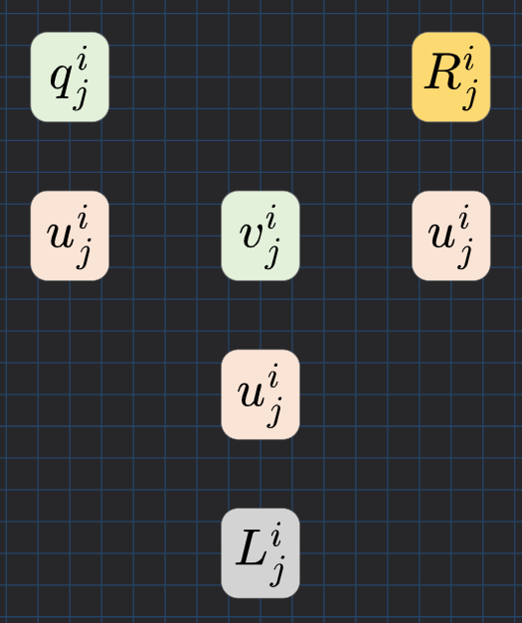
Select
Drag and drop BG components

Slide 6
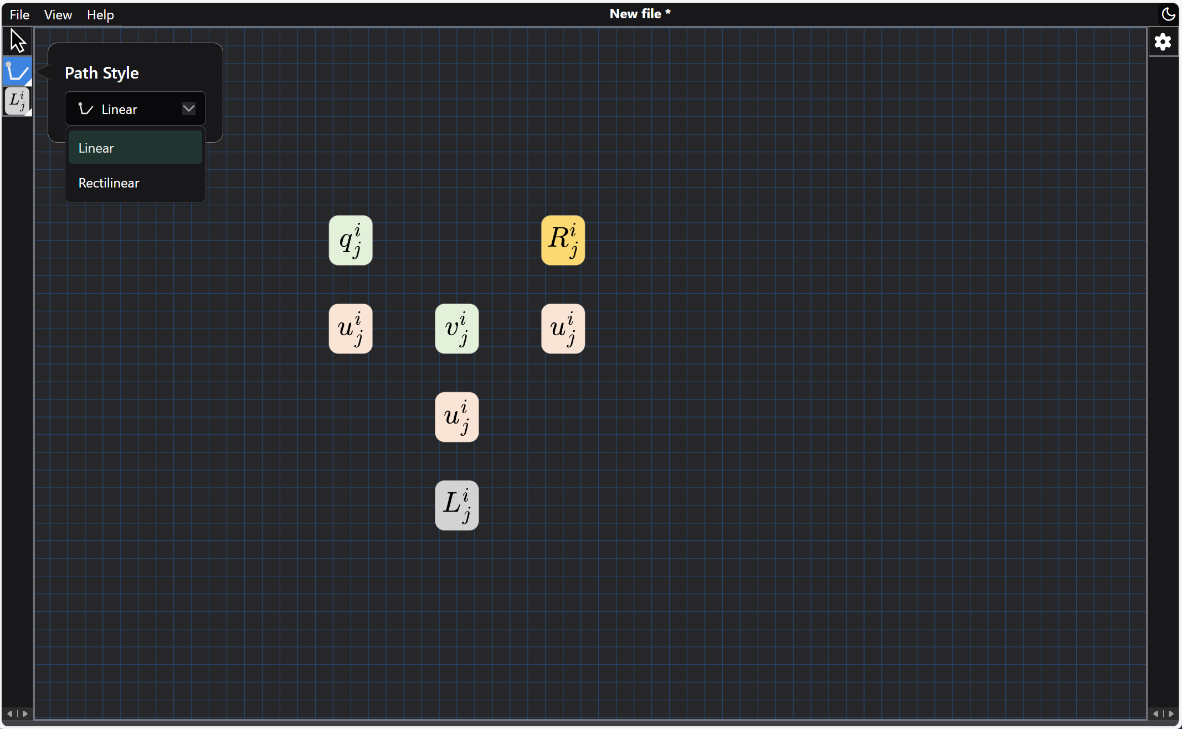
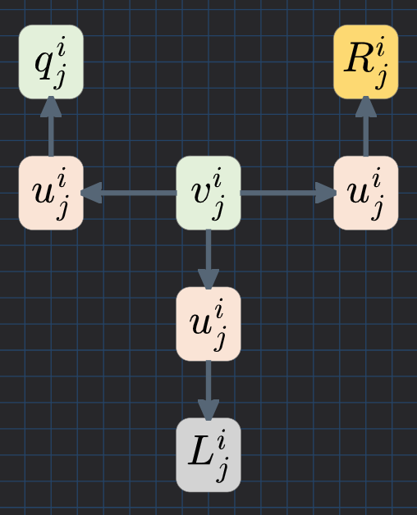
Select
Select path style
Click on 1st component then 2nd component

Slide 7
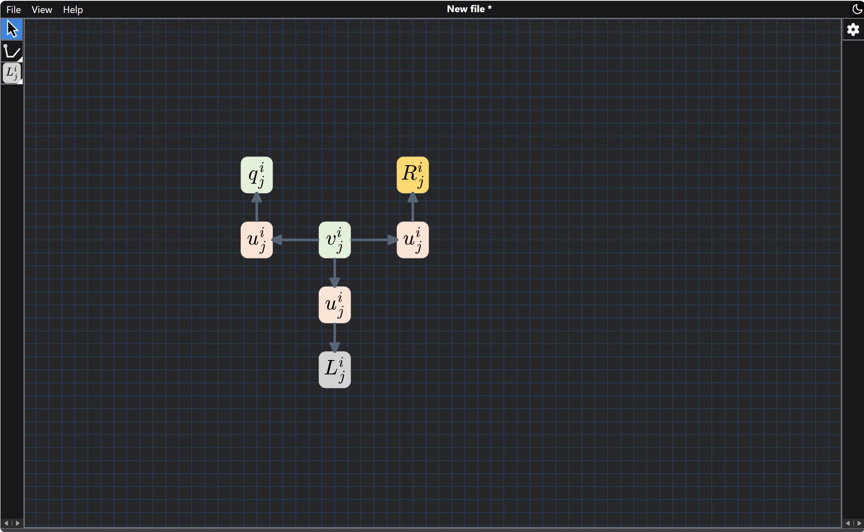
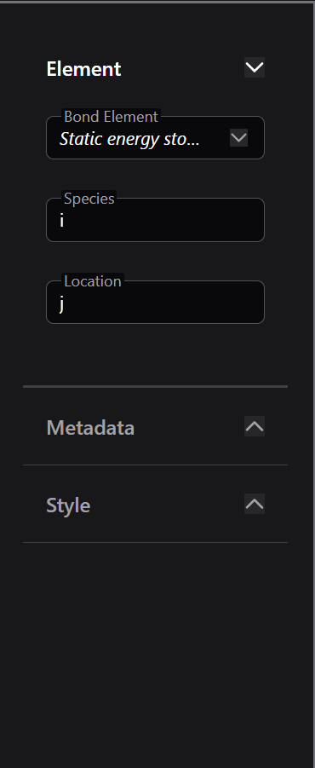
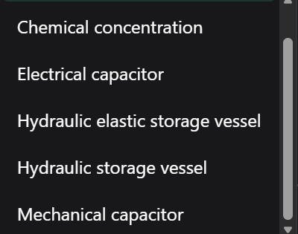
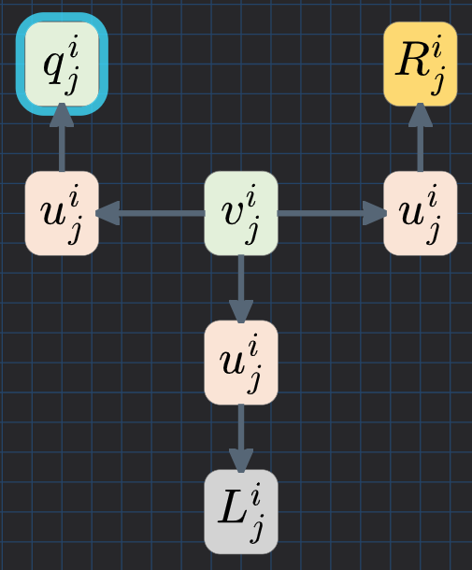
Select
Selection tool
Component properties
Select

Slide 8
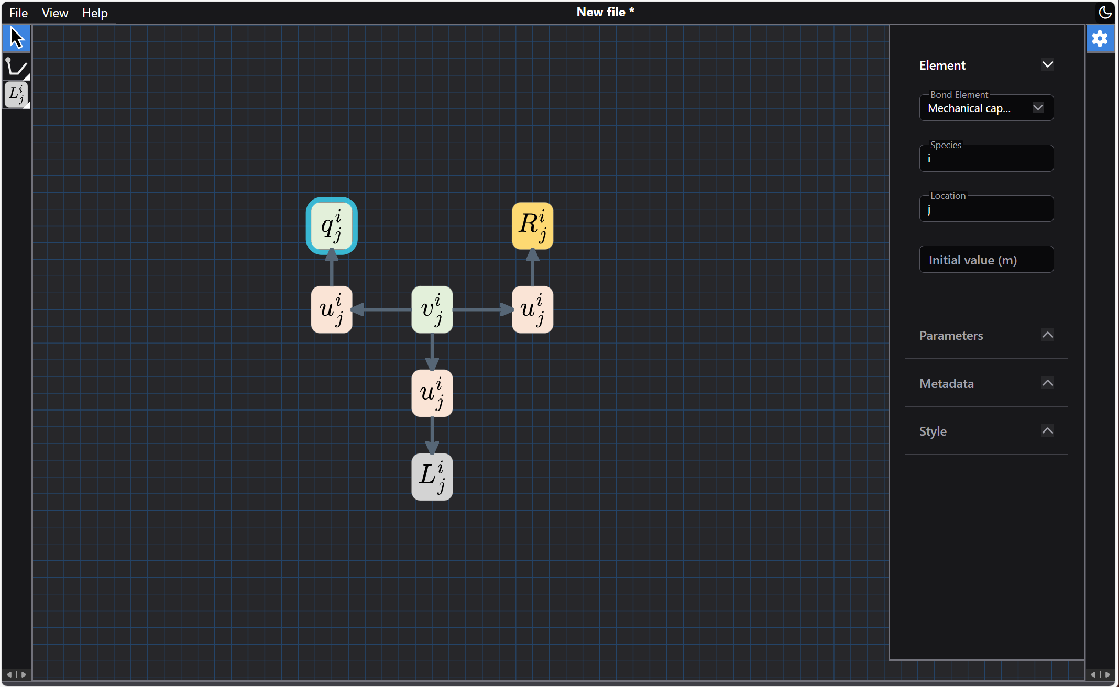
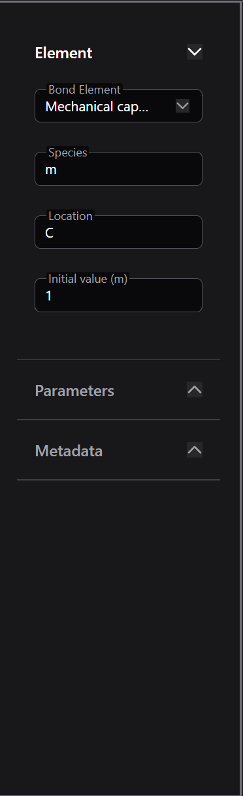
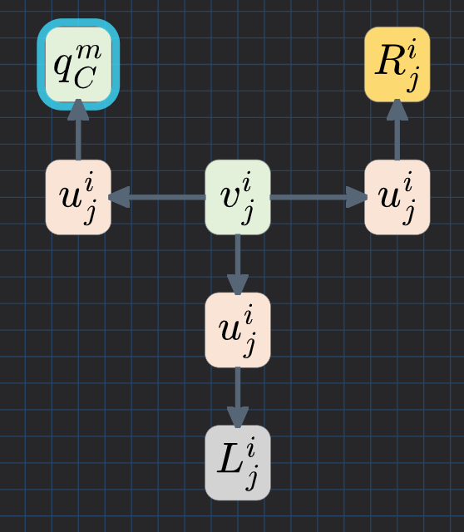
Set species,
location,
parameters
& initial value

Slide 9

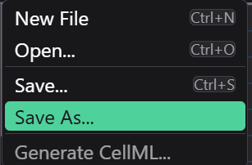
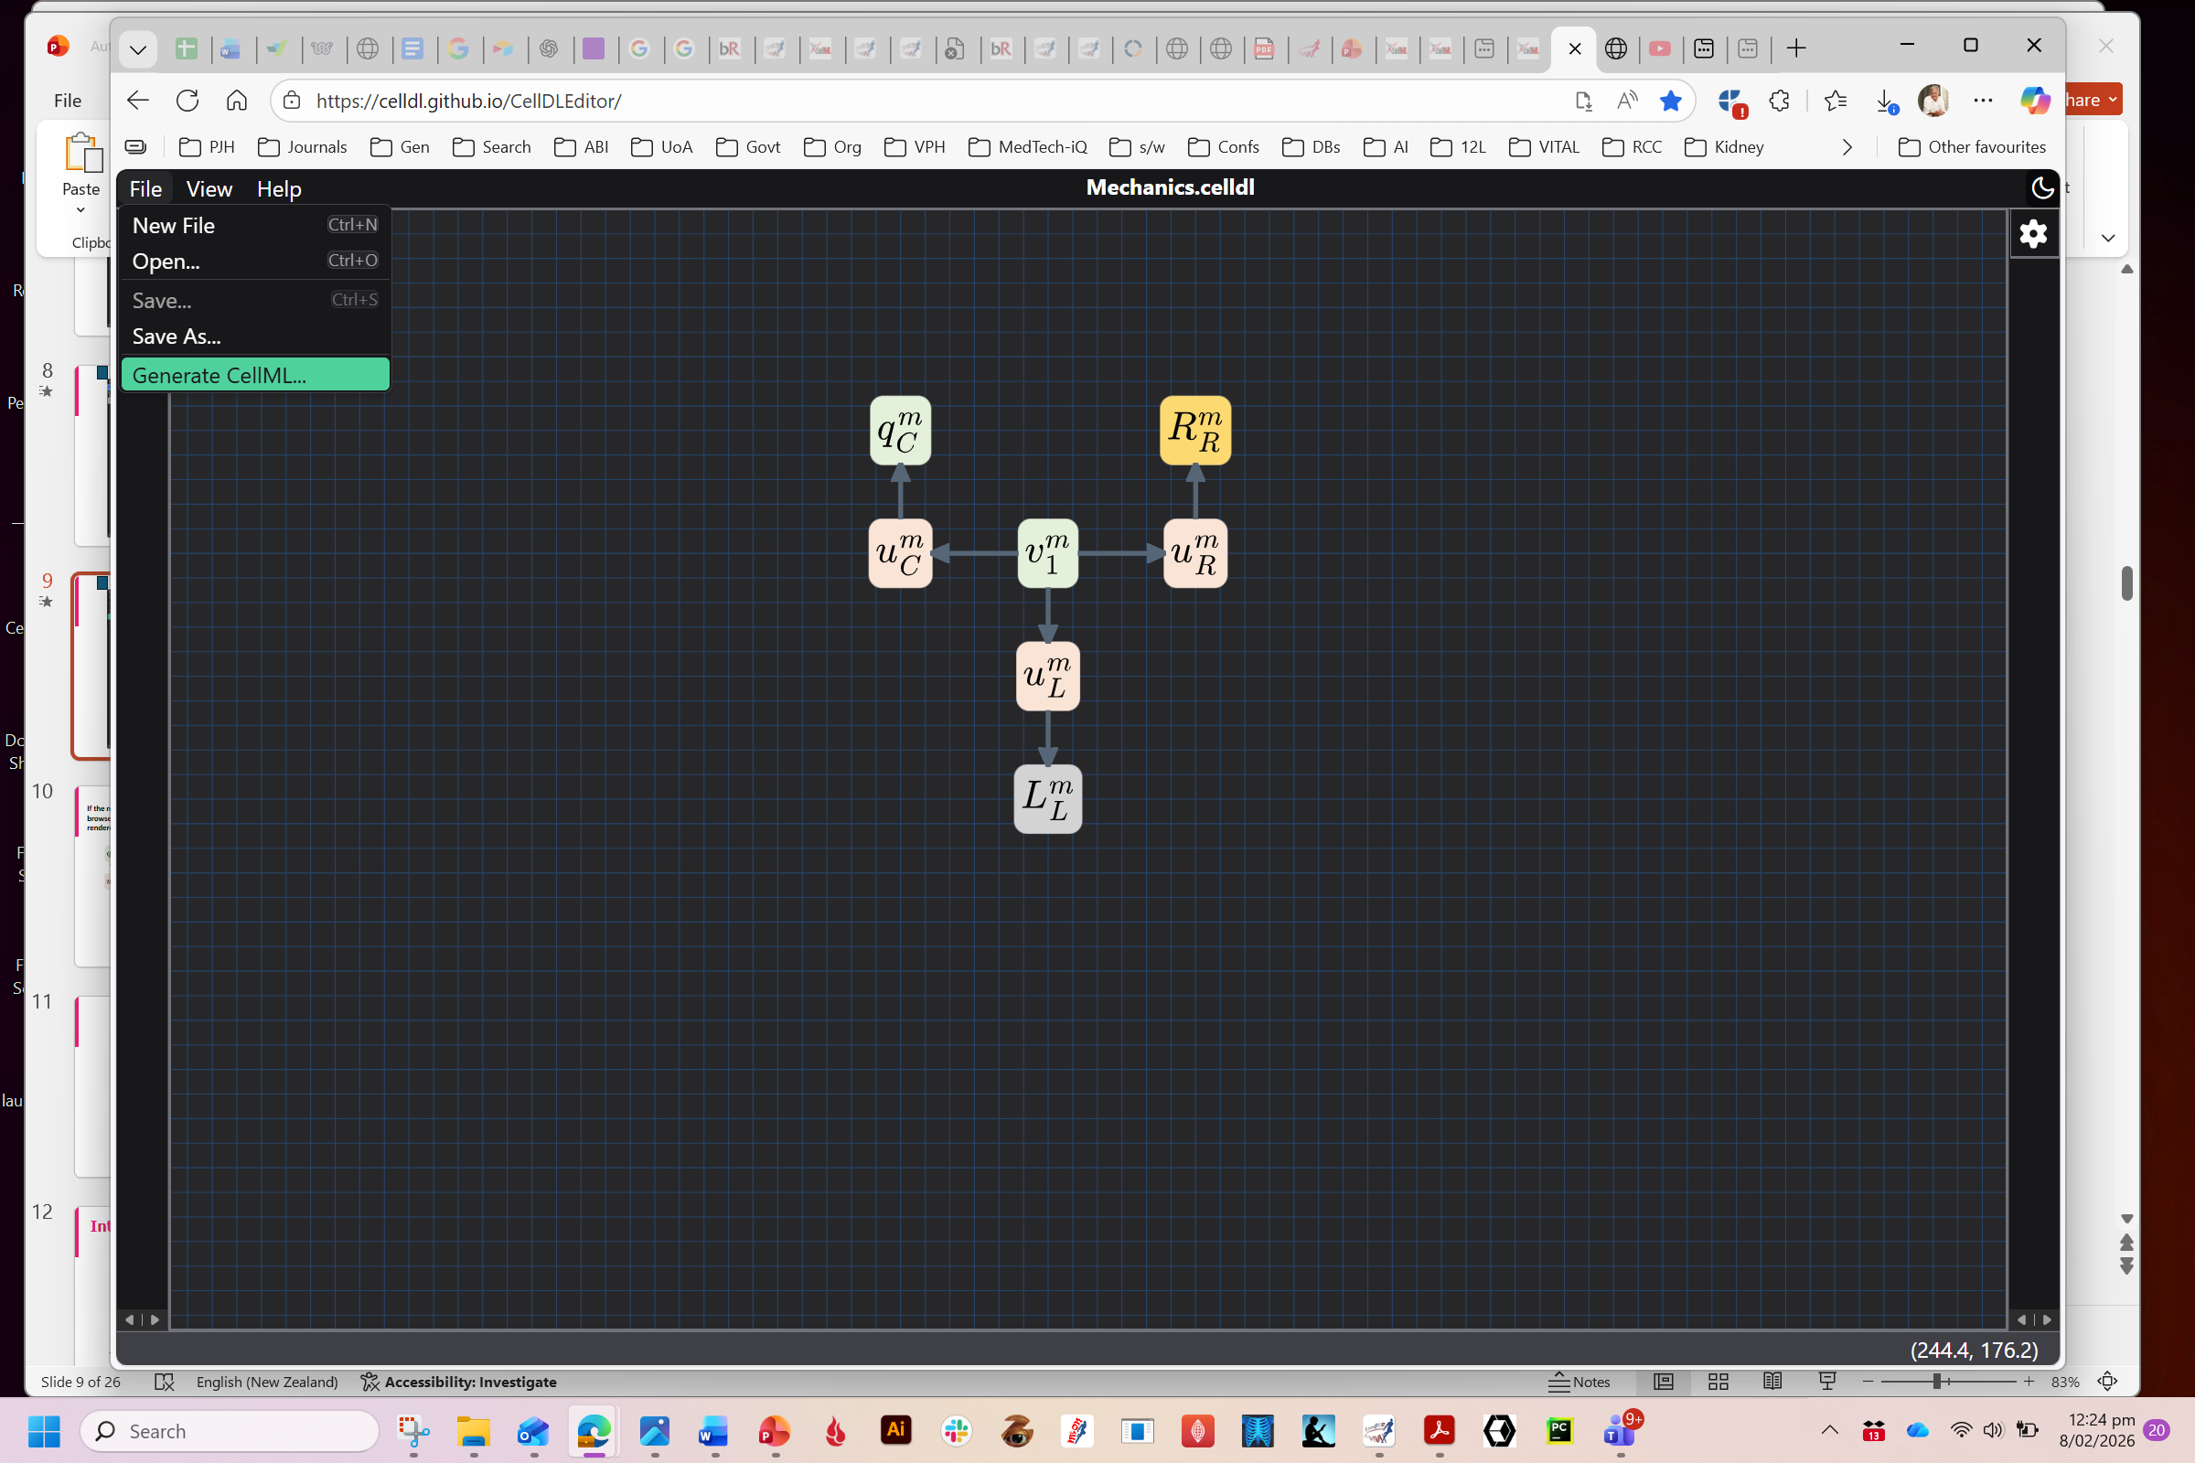
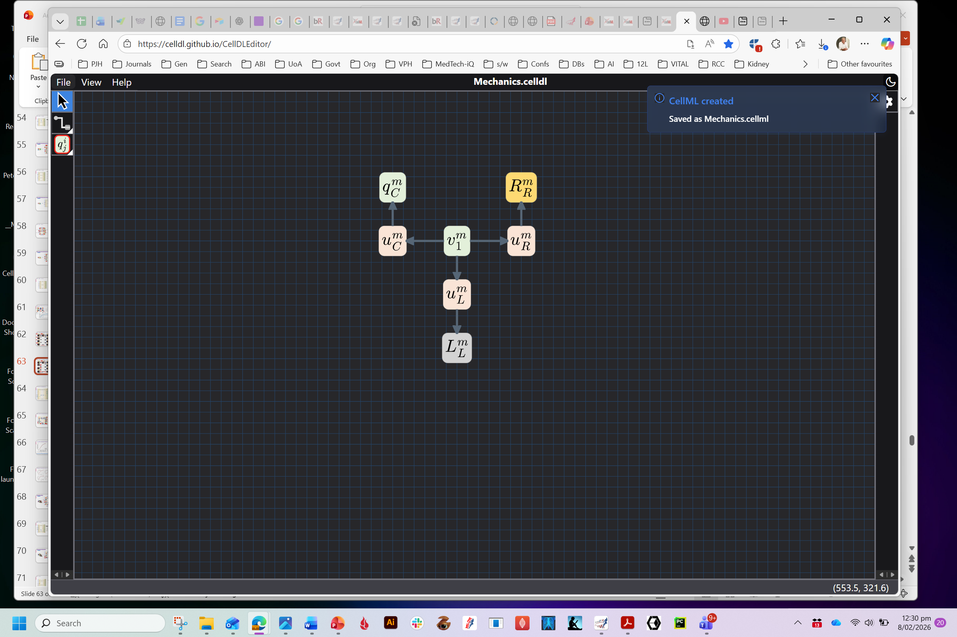
Save .celldl or .svg file
Generate .cellml file

Slide 10
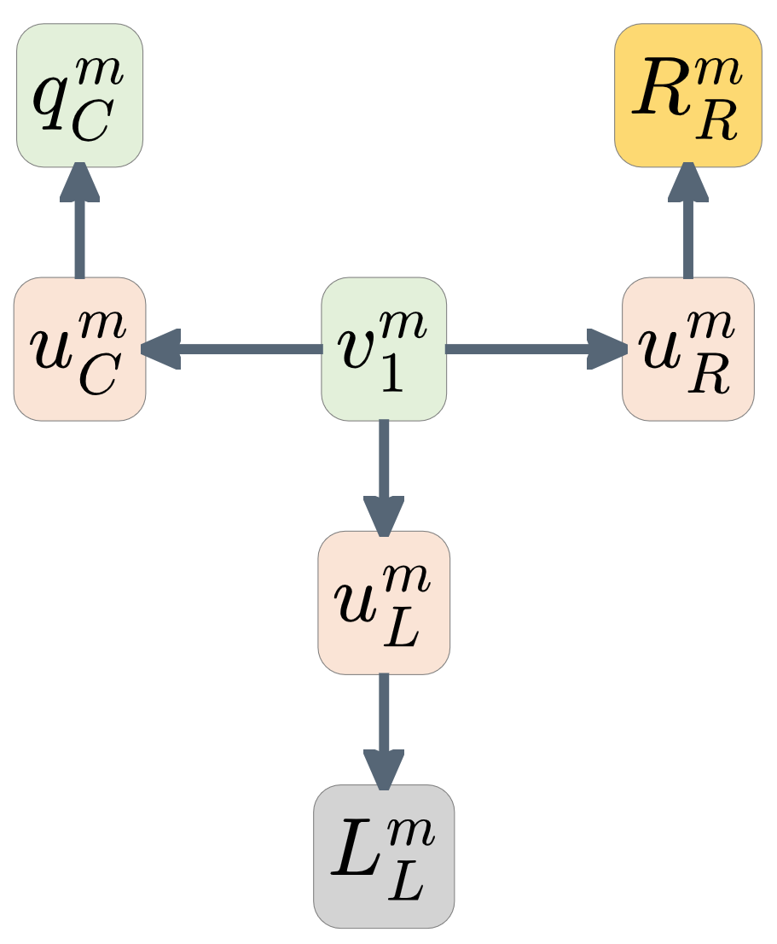
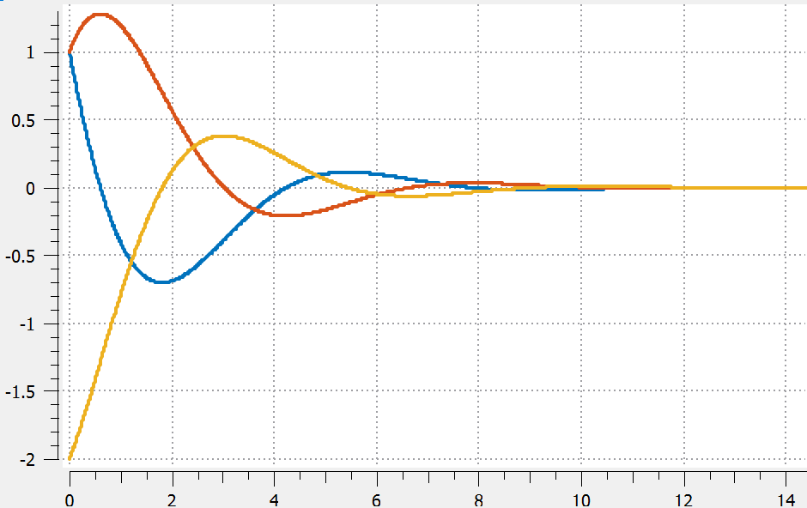
If the name.svg file is dropped onto a browser the bond graph diagram is rendered ..
The name.cellml file is available for use with the new Web app at https://opencor.ws/app
or legacy OpenCOR from https://opencor.ws

Slide 12
Interactive simulations with OpenCOR
The OpenCOR app is available at https://opencor.ws/app
Developer: Alan Garny, Auckland Bioengineering Institute

Slide 13
Mechanics example
Mass/spring/damper system
Bond graph model
$$C:q_{C}^{m}$$
R
$$u_{C}^{m}$$
$$u_{R}^{m}$$
$$v_{C}^{m}$$
$$v_{R}^{m}$$
C
R
$$u_{C}^{m}$$
$$v_{1}^{m}$$
$$u_{R}^{m}$$
$$u_{L}^{m}$$
$$u_{L}^{m}$$
$q_{1}^{m},v_{1}^{m}$
L
$$v_{L}^{m}$$
L$:{\dot{v}}_{L}^{m}$

Slide 14
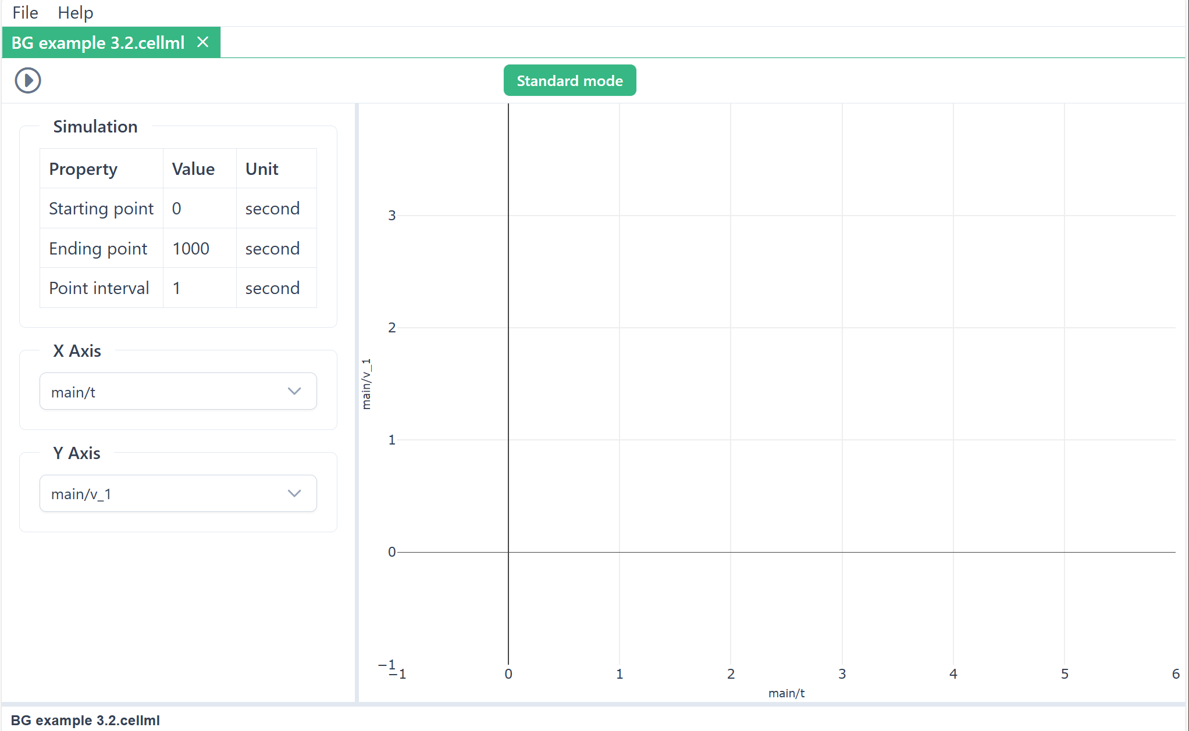
1. Drag & drop your .cellml file onto https://opencor.ws/app

Slide 15
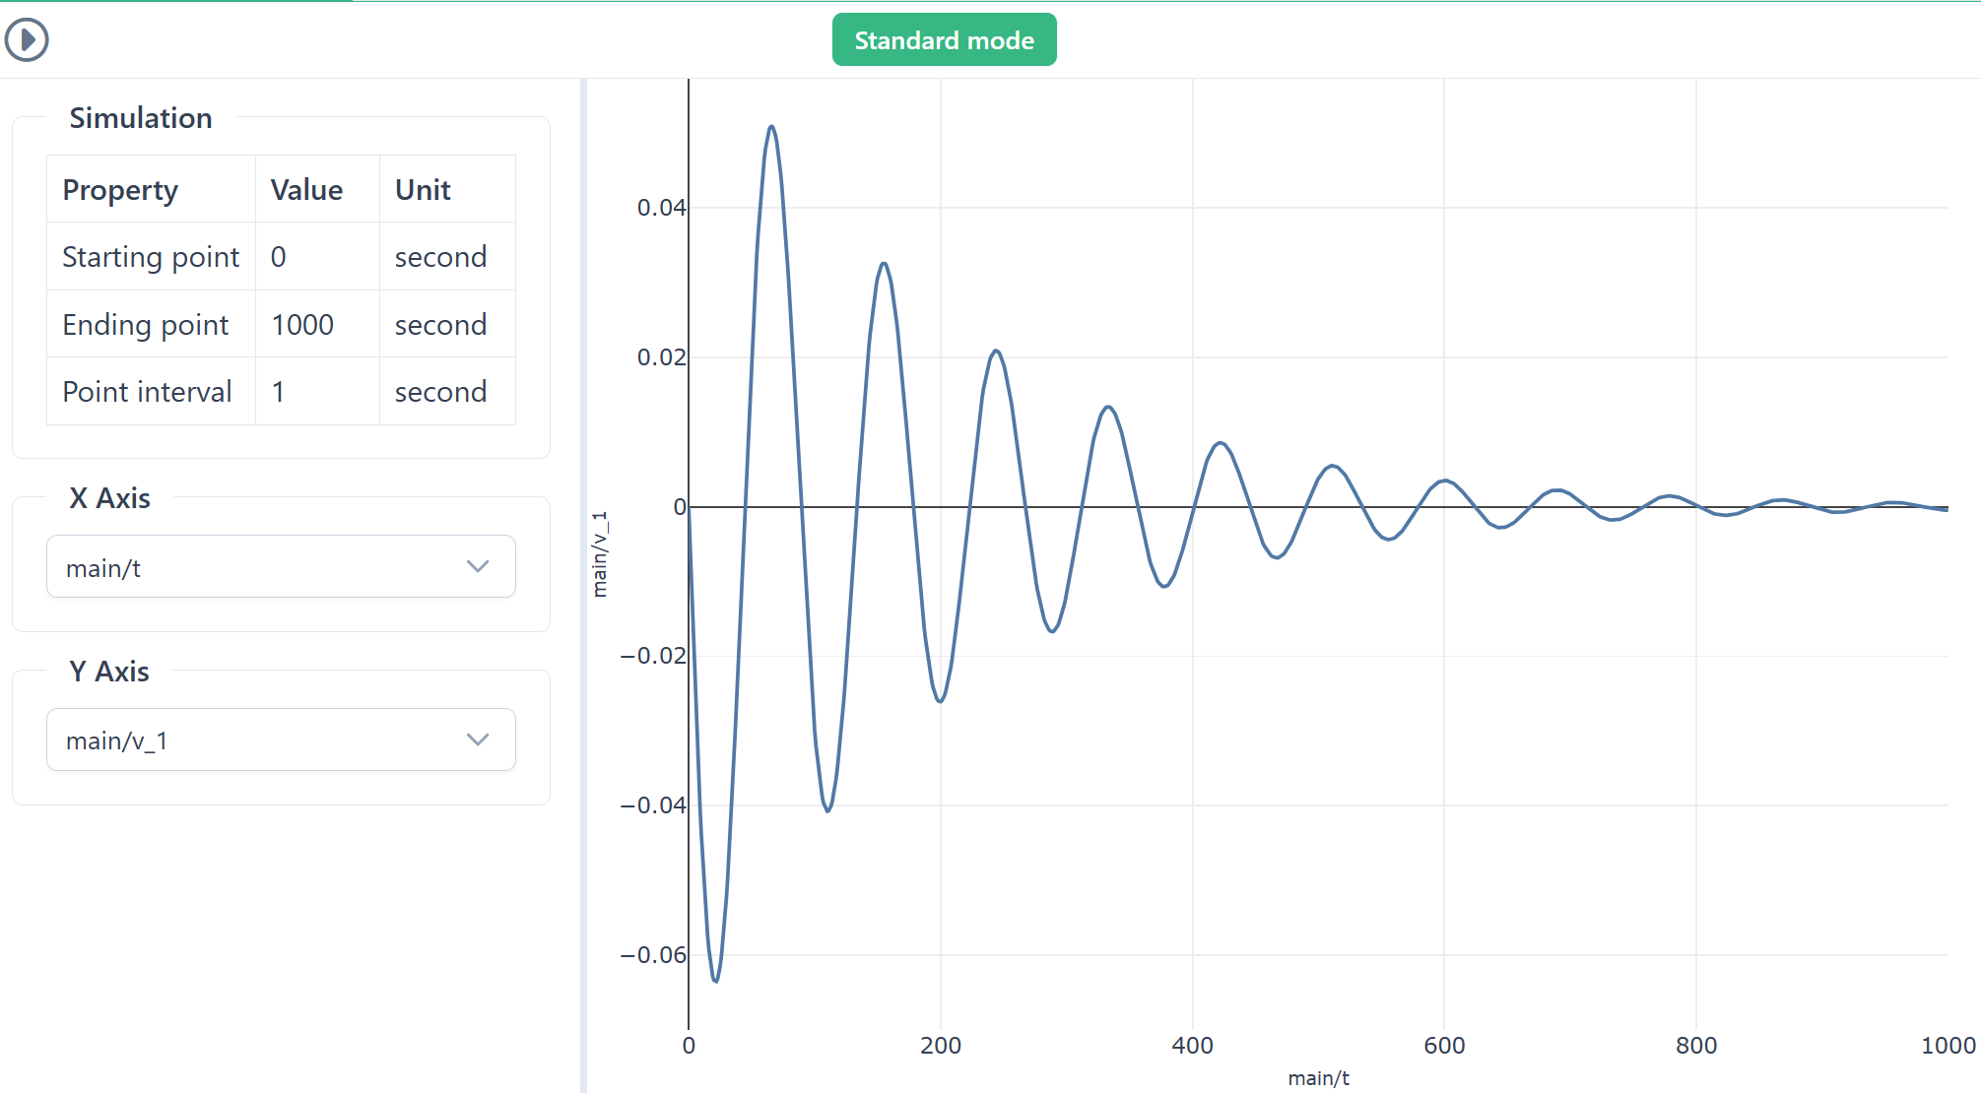
2. Run the model in ‘Standard mode’
Click on Run button
Click here to switch modes
This uses default plotting parameters

Slide 16
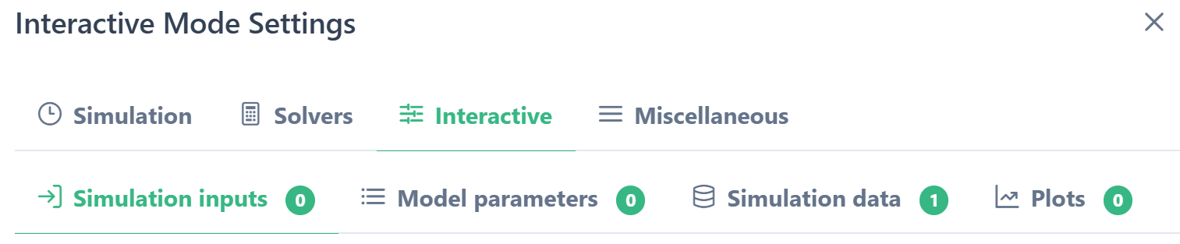
3. Interactive mode plot settings
Interactive mode
.. then requires Settings
c

Slide 17
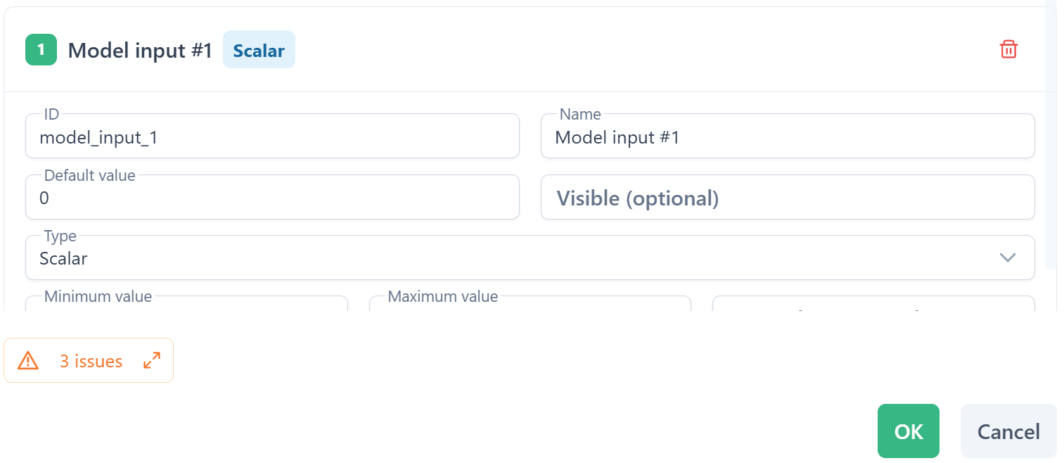
Configure the simulation inputs that a user can modify and that will be available to set the model parameters

Slide 18
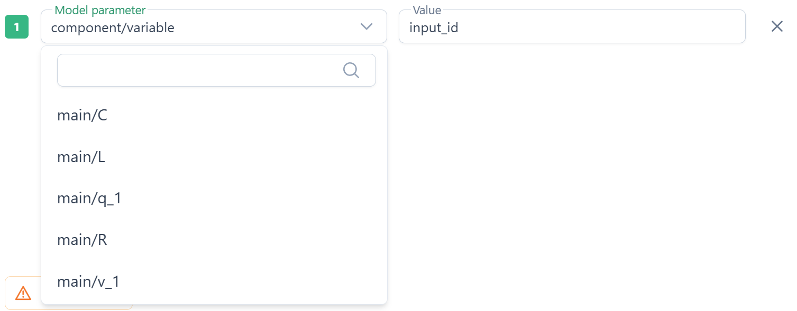
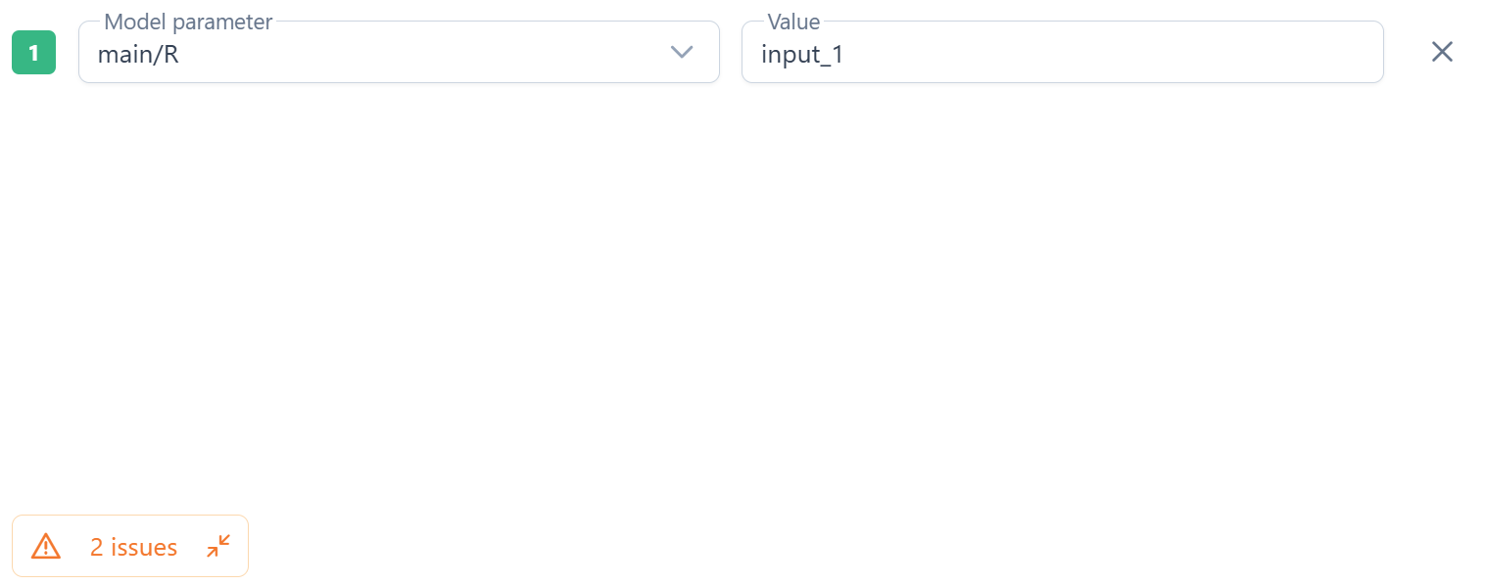
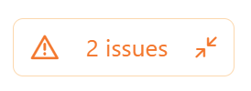
Choose the model parameters using the value of the simulation inputs

Slide 19
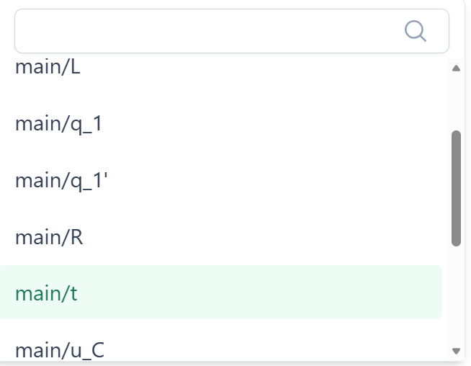
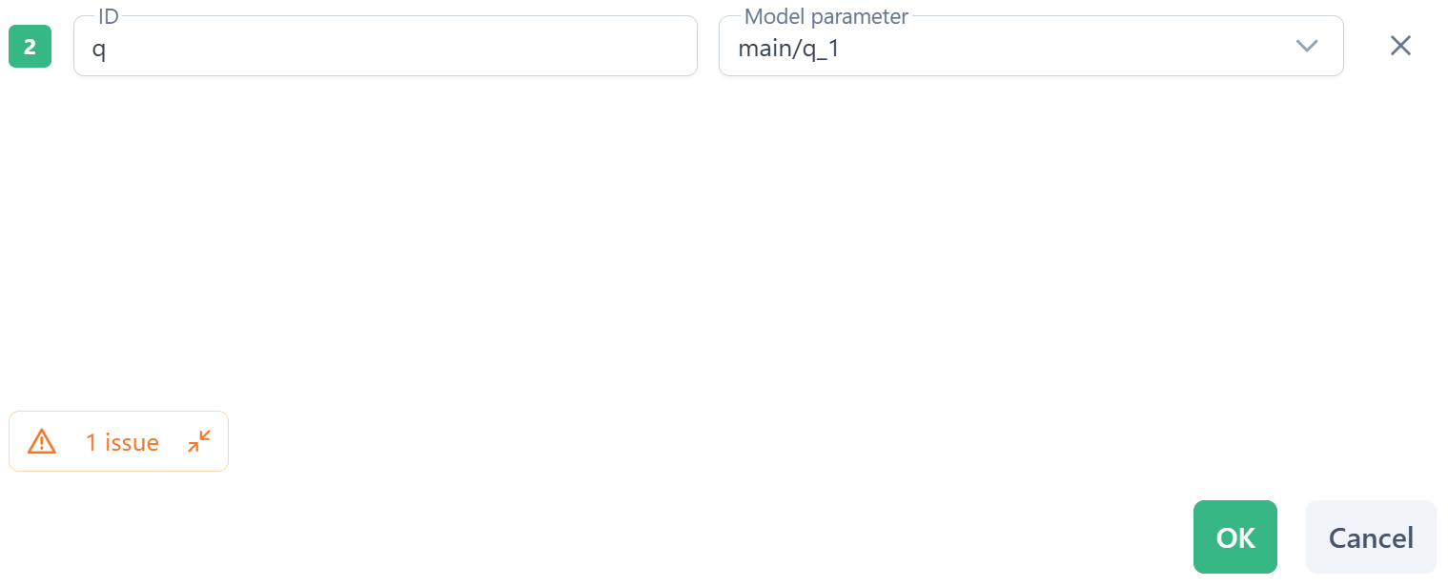
Choose the model output data for plotting

Slide 20
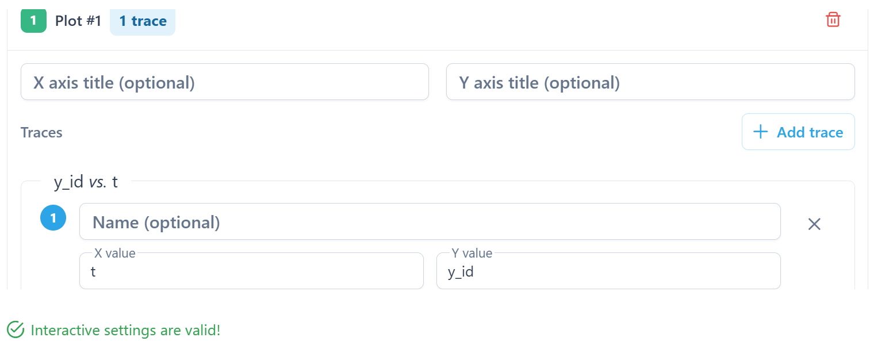
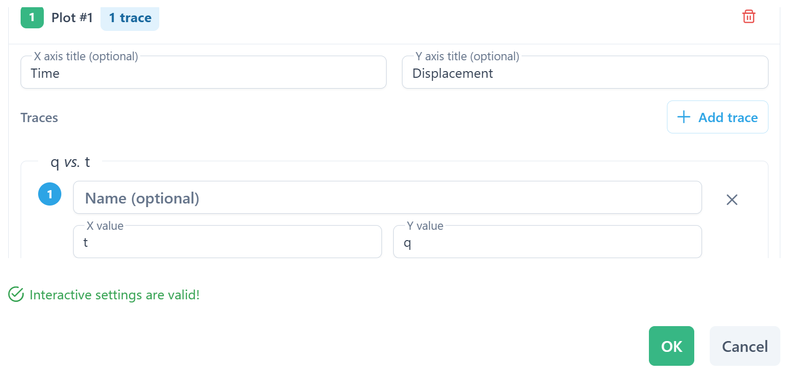

Configure the plots and traces within each plot using the simulation data
Plot configuration complete

Slide 21
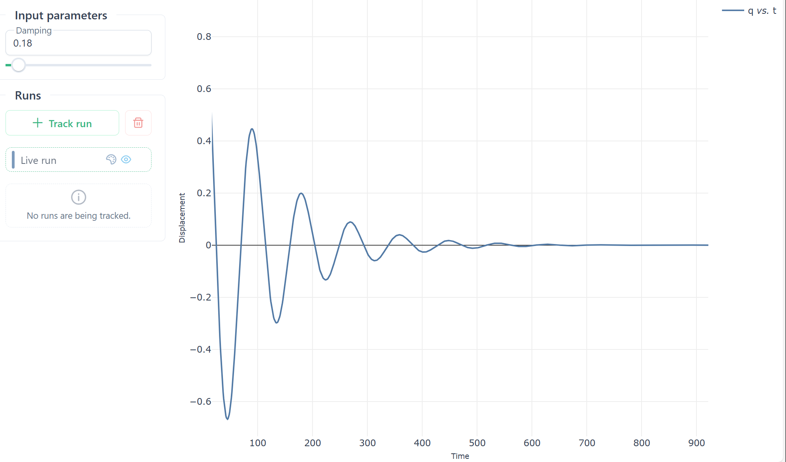
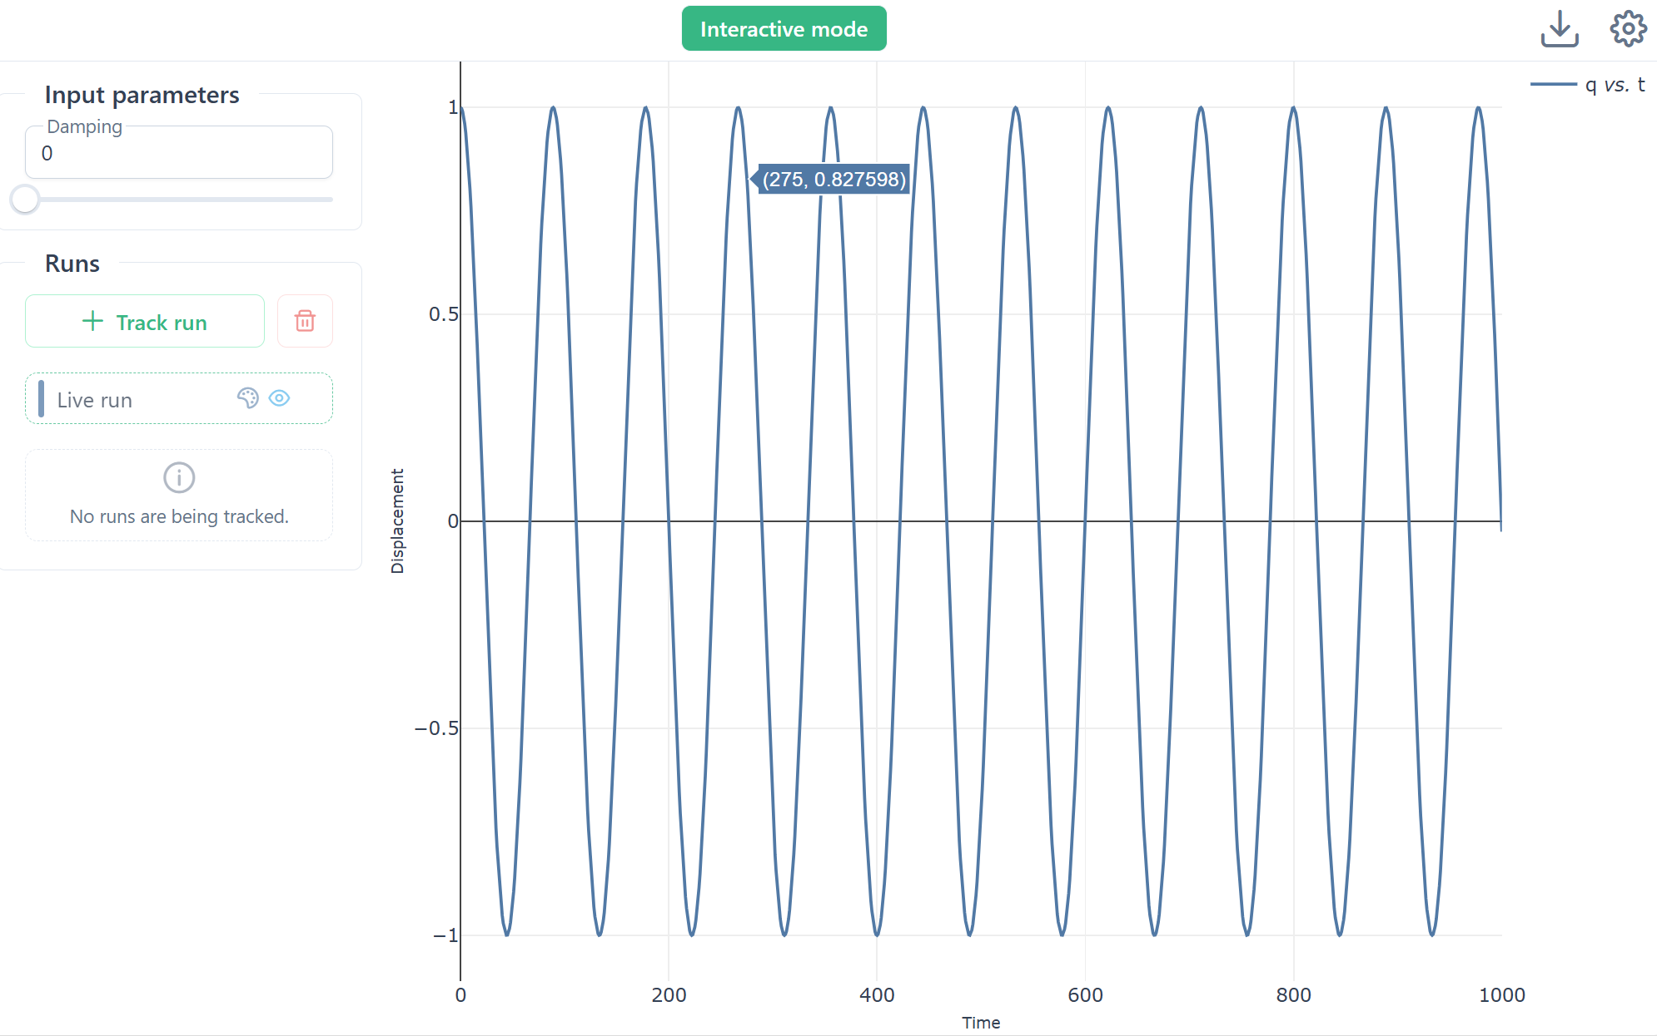
4. Interacting with the model
Input controls

Slide 22
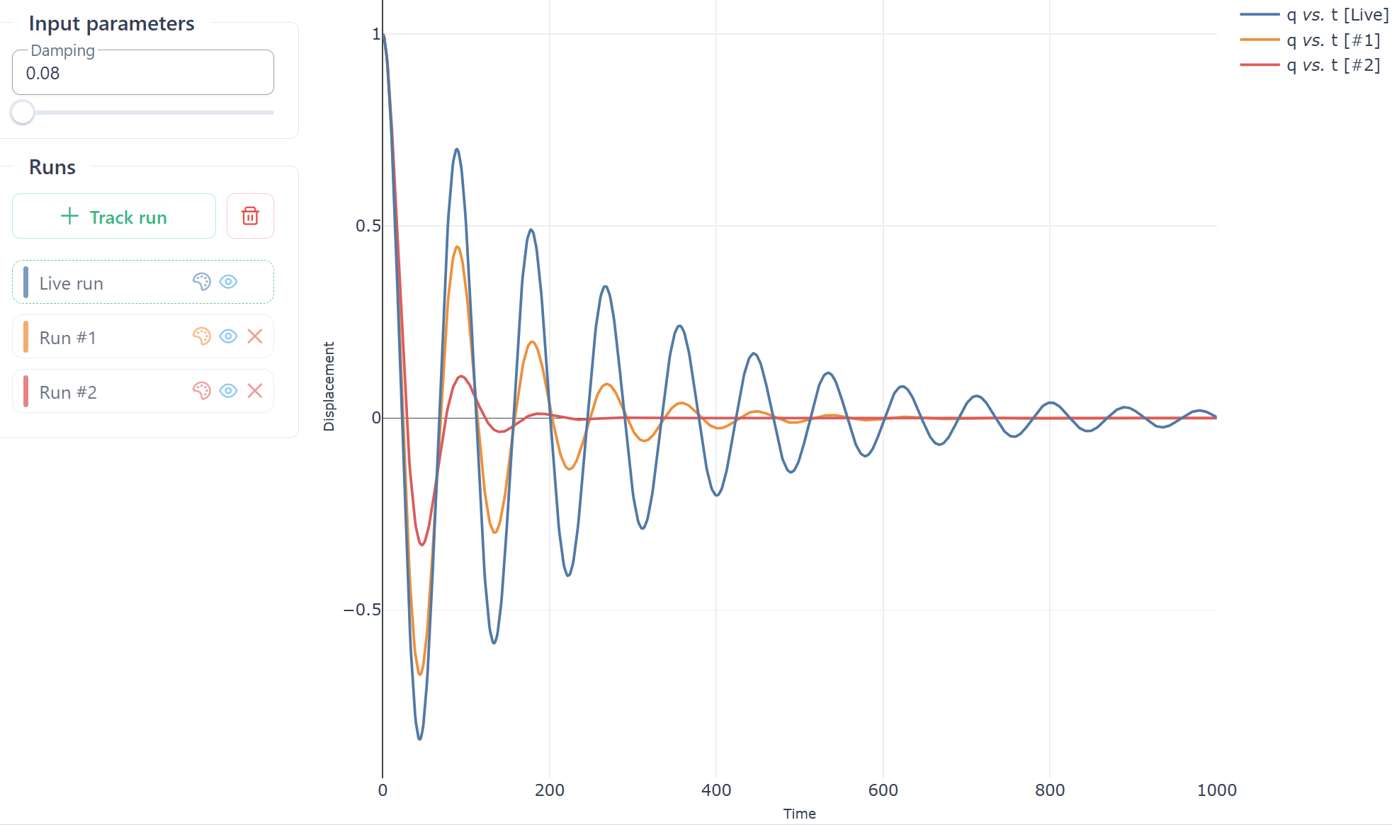

5. Retaining solutions & saving model + plot config
Save .omex file
Hovering over a trace, identifies the Run #
Toggle visibility, delete, set colour

Slide 23
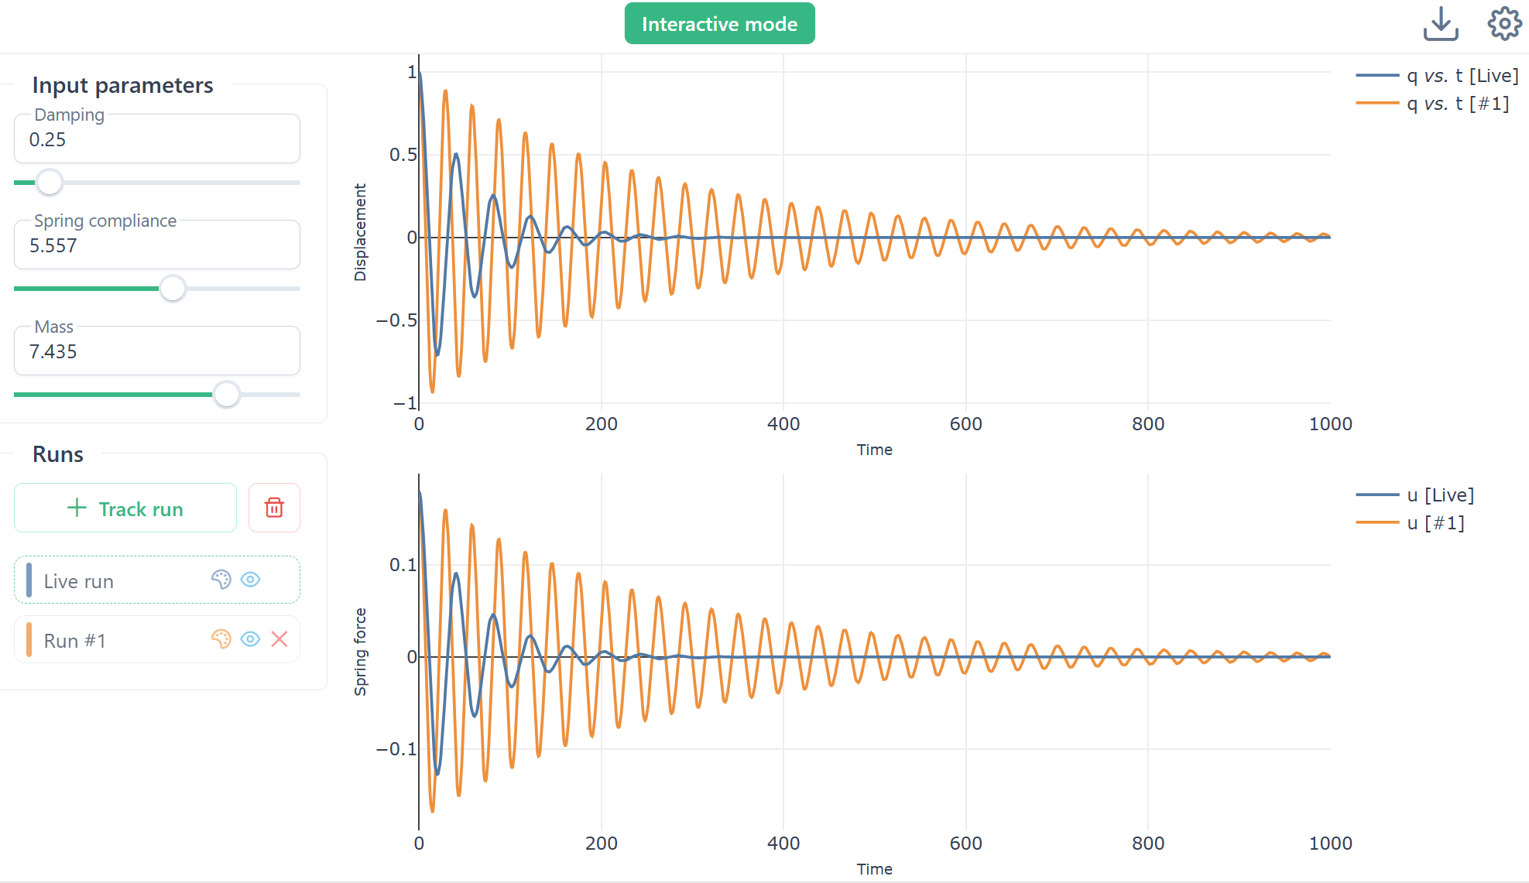
6. Adding simulation inputs and additional plots

Slide 24
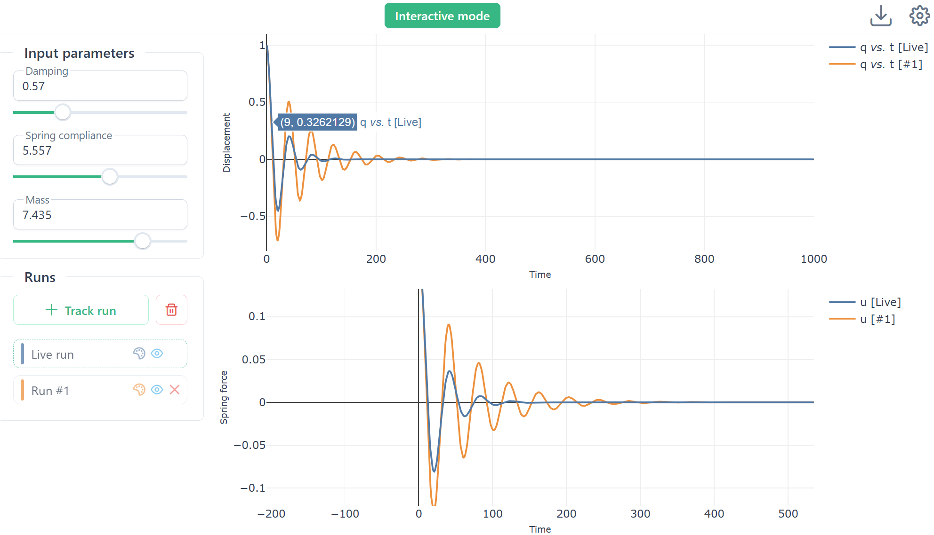
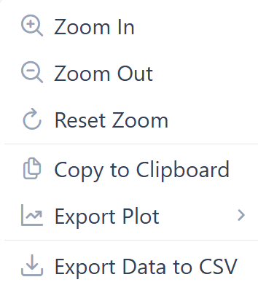

7. Zooming, panning and saving plots
Zooming etc & exporting graphics

Slide 25

8. Advanced features

Slide 26
Thank you!

